Slide 1









Remote
Merged “title” and “main text body” of every post
Removed URLs, punctuations, numbers, and whitespaces
Converted text to lowercase
Dropped duplicates
Input
Variable length “clean text” for every Reddit post from Step 2
Server
Posts count = c.1.51m
Subreddits count = 55
Model
Universal Sentence Encoder (USE)
Pushshift Reddit
API
Step 2. Data preprocessing
Output
512 dimensional feature vector
SQLite Database
Step 3. Feature selection
Posts count = c.1.69m
Subreddits count = 55
Sample 1 & Sample 2,
posts count = 150,000 each
Step 1. Data collection
Step 5. Sampling
K-means clustering algorithm
UMAP scatter plots
Random forest binary classifier
Word clouds
Keywords and domain knowledge
Elbow method
Selected posts count = c.1m
Selected subreddits count = 54
Word shift graphs
Optimum no. of clusters (merged & finalized) = 12
Optimum no. of clusters
(identified) = 20
Word trees
Step 4. Data exploration
Step 7. Visualization and results interpretation
Step 6. Clustering and optimization

Slide 2




a
b
Count of Reddit posts in SQLite database
= 1.69m
Top 25 subreddits by posts count
c
d
Data exploration
Count of posts excl. “EcoInternet” subreddit
= 991,168

Slide 3
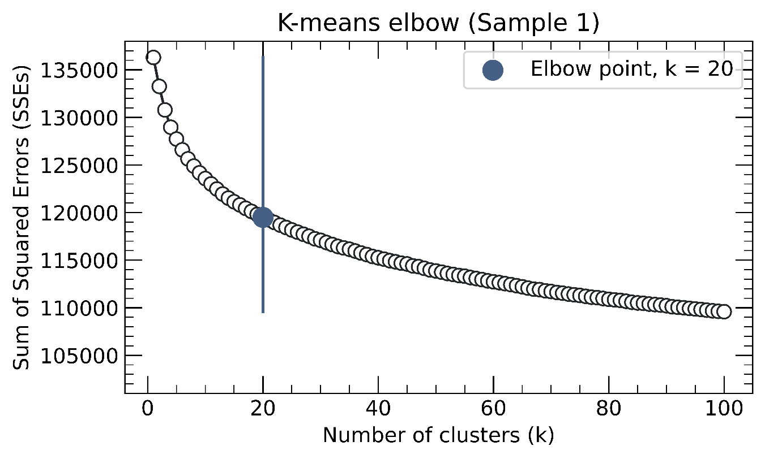

a
b

Slide 4
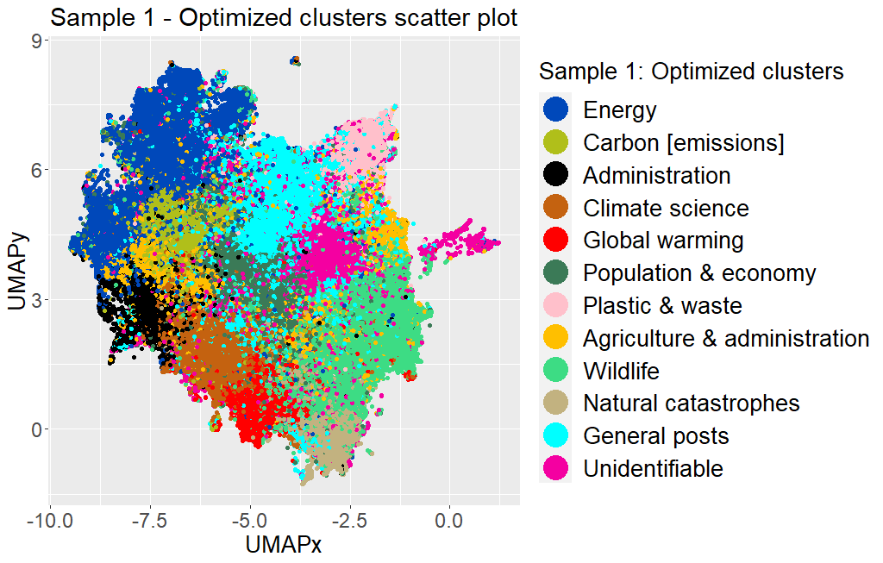
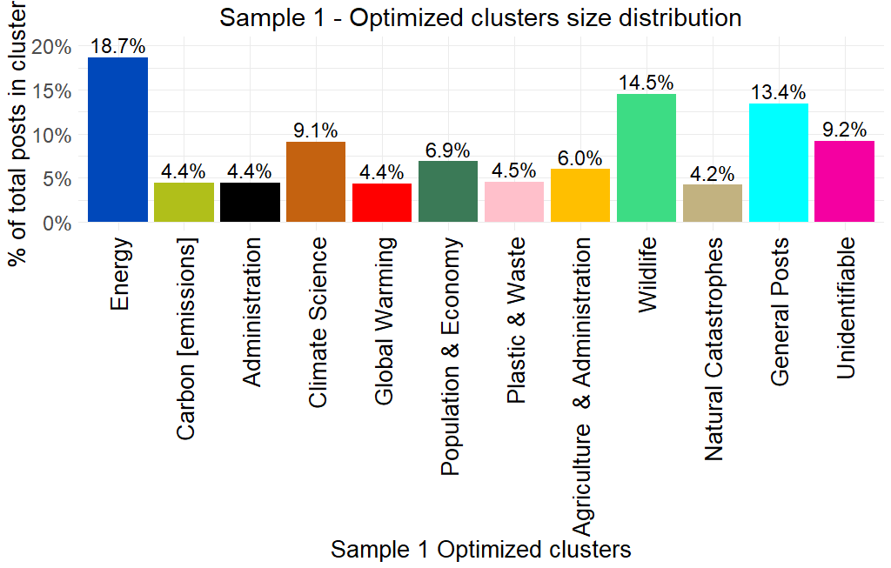
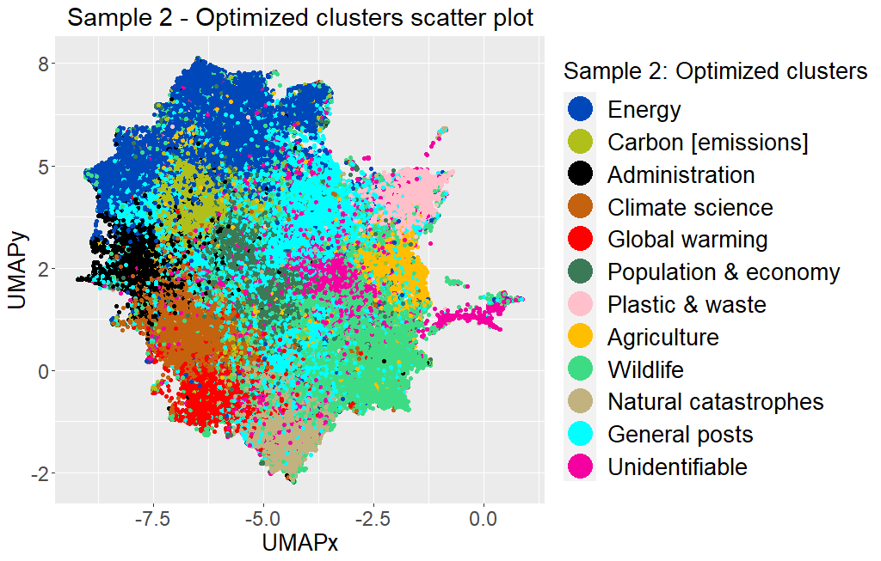
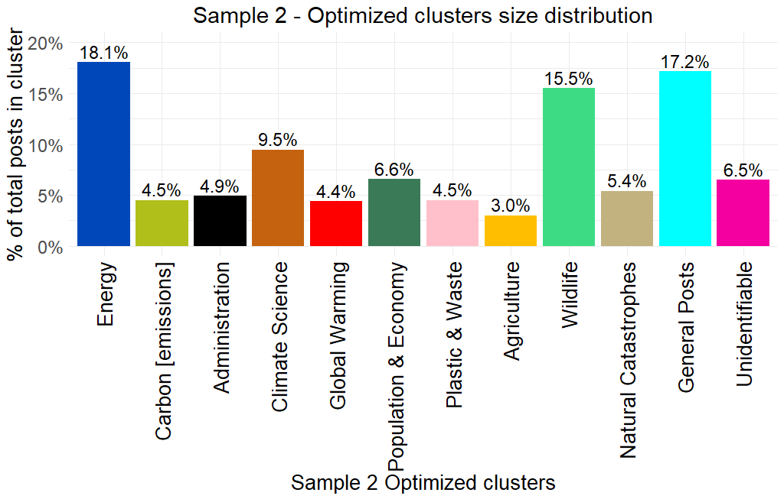
a
b
c
d

Slide 5
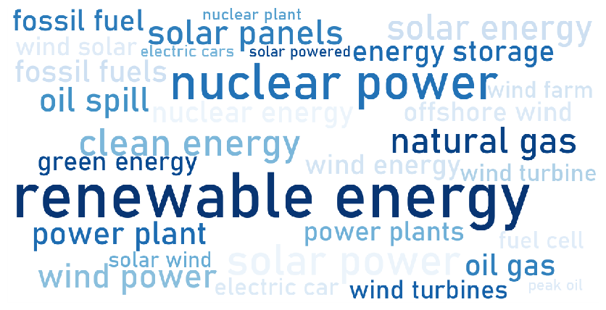
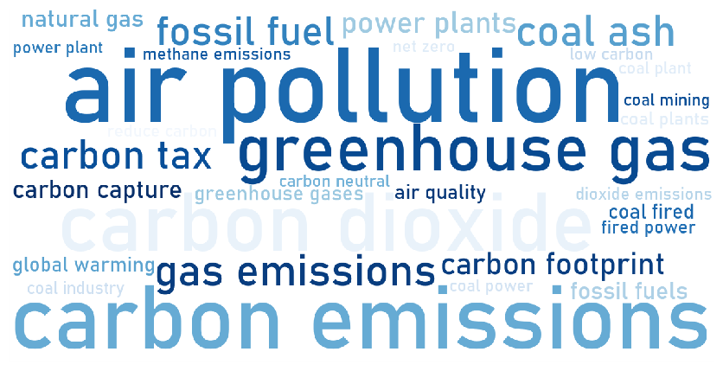
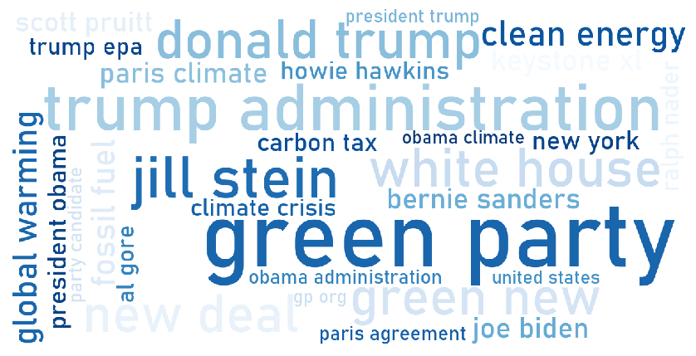
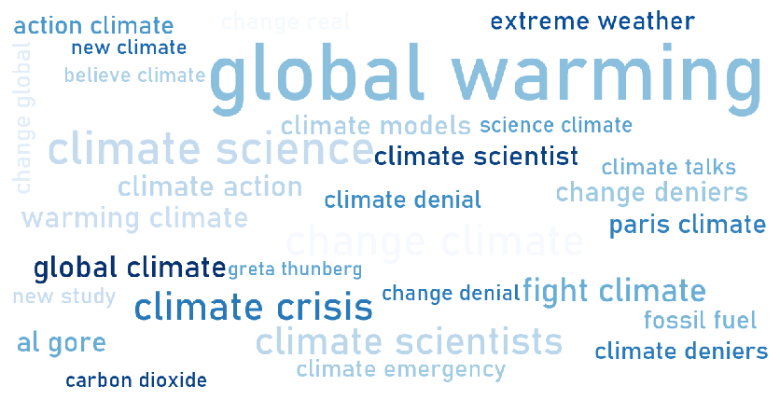
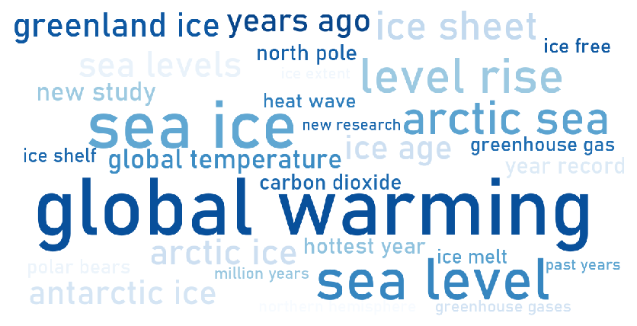
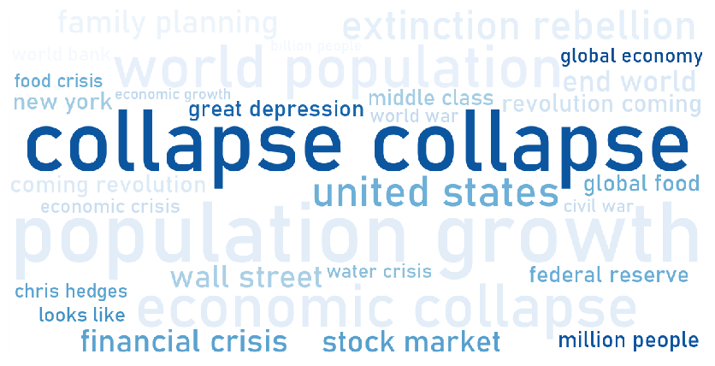
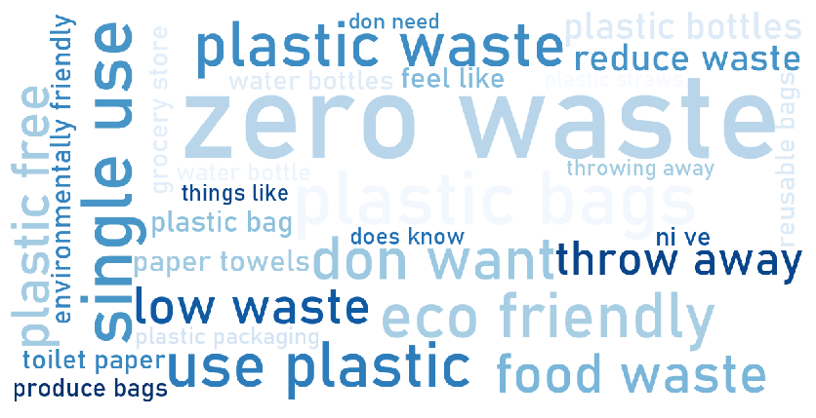
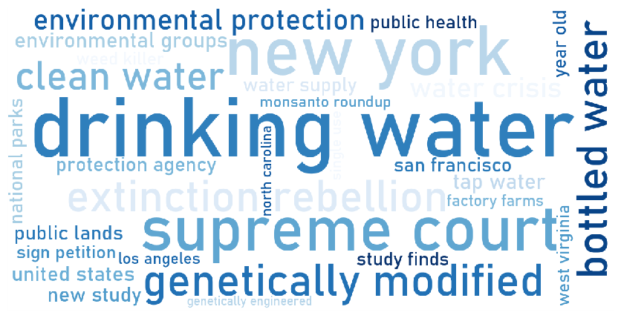
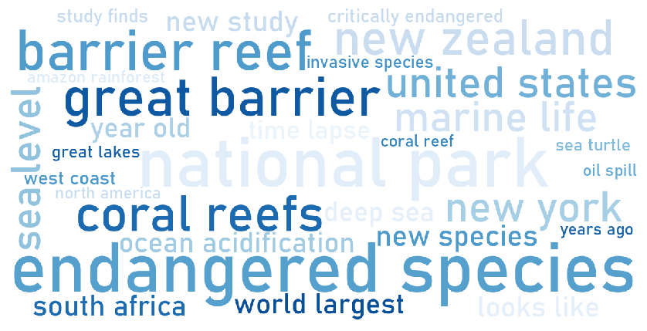
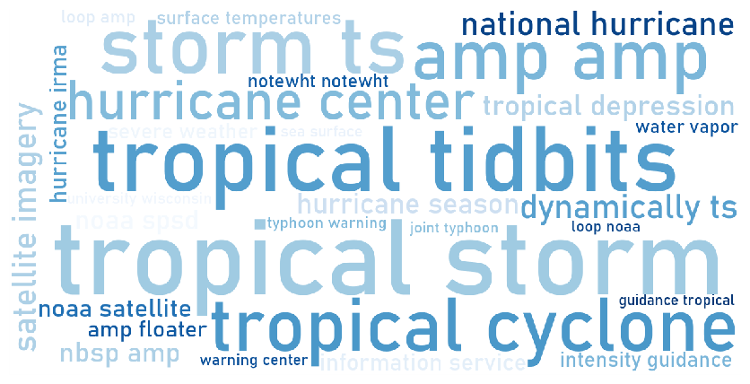
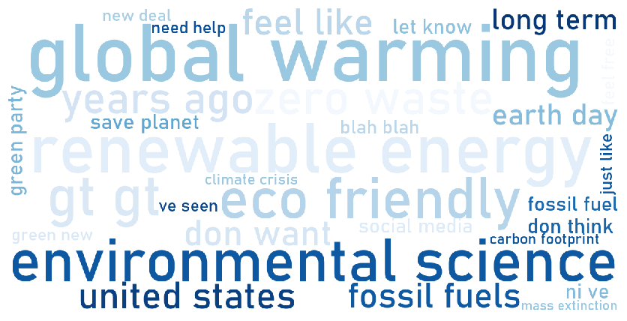
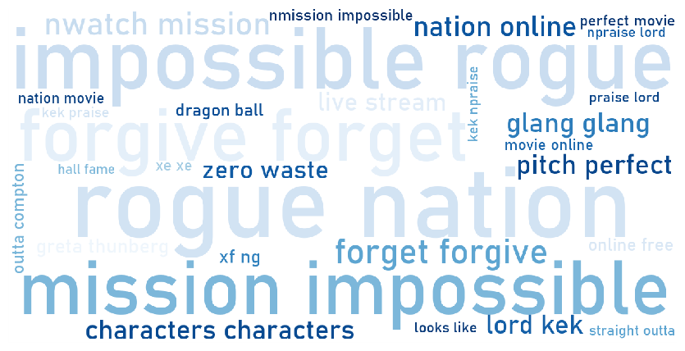
a
Cluster 1 - Energy
b
Cluster 2 - Carbon [emissions]
c
Cluster 3 - Administration
d
Cluster 4 - Climate science
e
Cluster 5 - Global warming
f
Cluster 6 - Population & economy
g
Cluster 7 - Plastic & waste
h
Cluster 8 – Agriculture and administration
i
Cluster 9 - Wildlife
j
Cluster 10 - Natural catastrophe
k
Cluster 11 - General posts
l
Cluster 12 - Unidentifiable

Slide 6
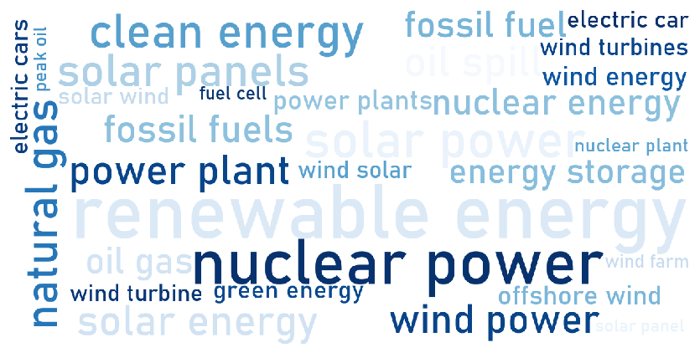
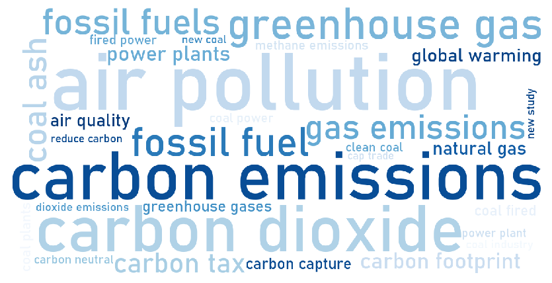
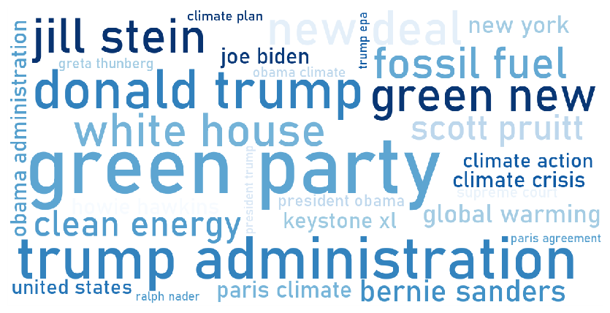
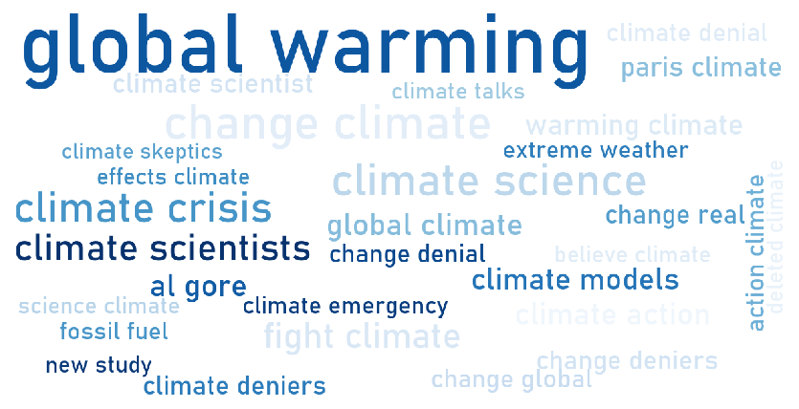
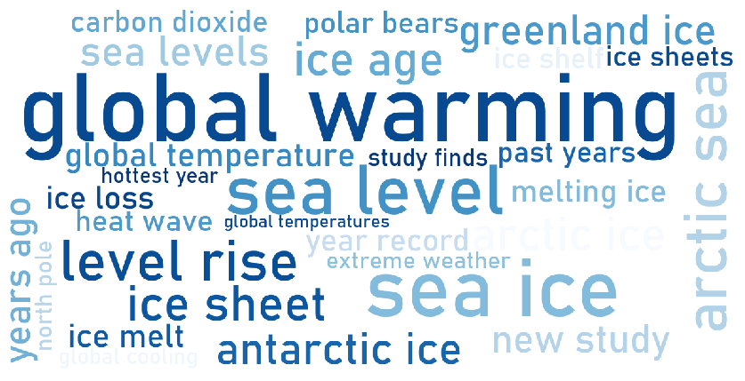
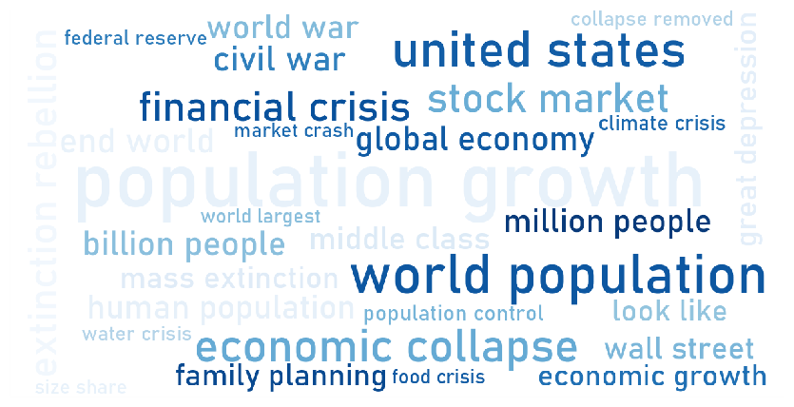
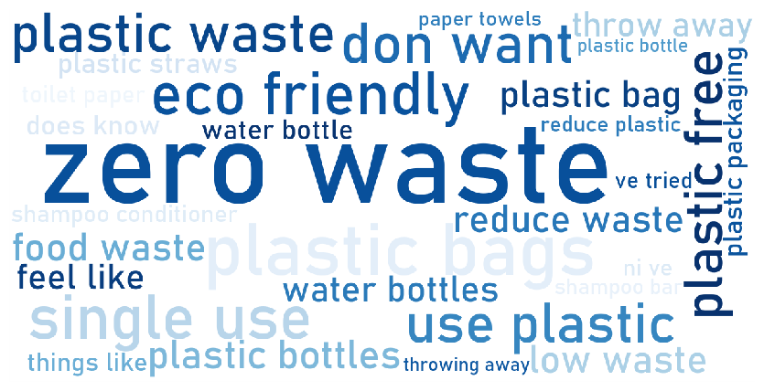
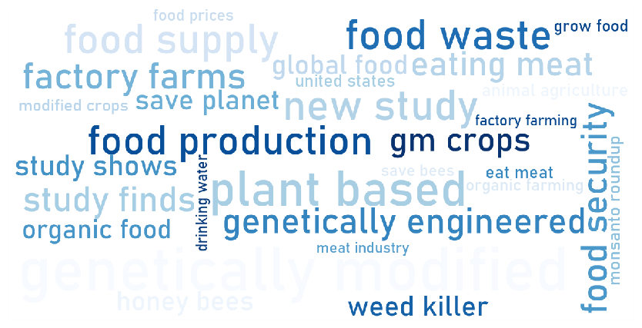
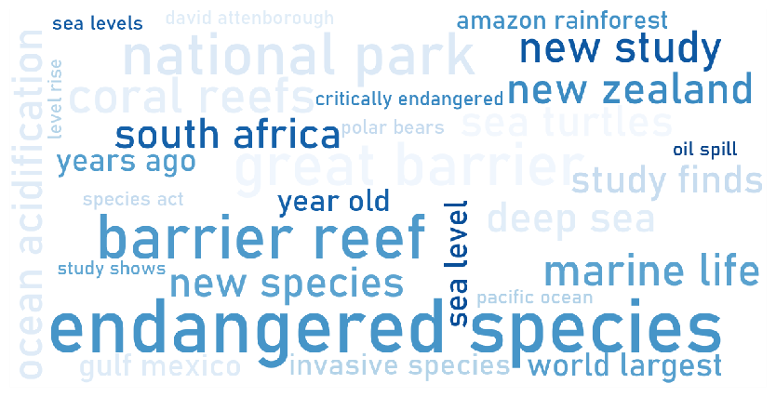
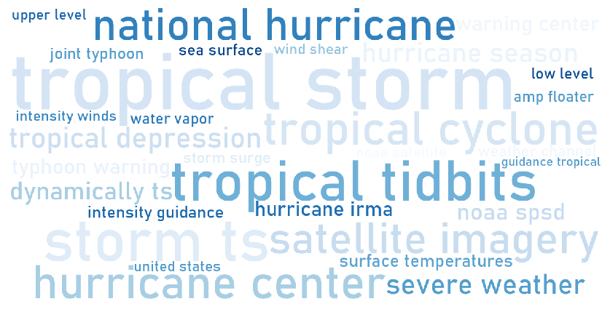
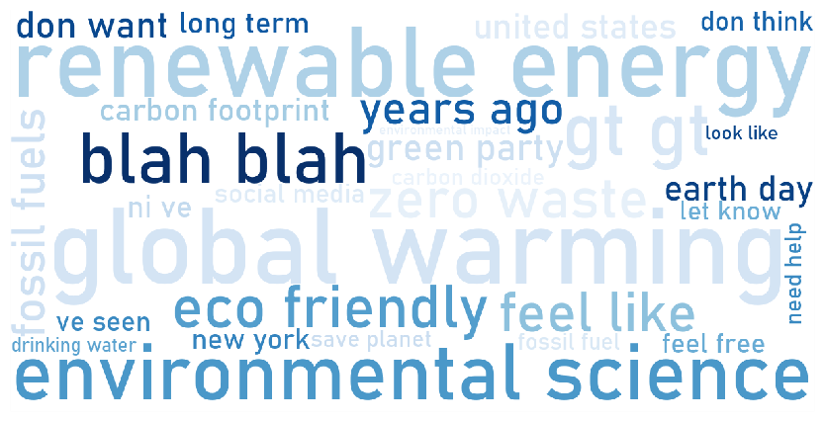
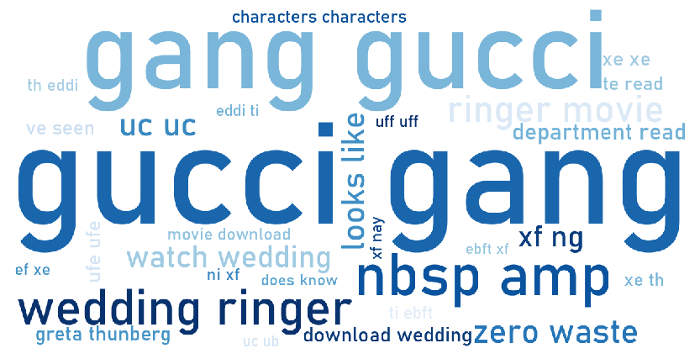
a
Cluster 1 - Energy
b
Cluster 2 - Carbon [emissions]
c
Cluster 3 - Administration
d
Cluster 4 - Climate science
e
Cluster 5 - Global warming
f
Cluster 6 - Population & economy
g
Cluster 7 - Plastic & waste
h
Cluster 8 – Agriculture
i
Cluster 9 - Wildlife
j
Cluster 10 - Natural catastrophe
k
Cluster 11 - General posts
l
Cluster 12 - Unidentifiable

Slide 7
Sample 1
Sample 2
Mean
+1 Std. Dev.
-1 Std. Dev.
a
b
c
1
2
3
4
6
9
5
7
8
d
e
f
10
13
14
11
12
7
15
g
h
i
17
19
20
16
18
j
k
l
21
23
22

Slide 8
1
Oil price shock (2008)
11
IPCC issues stark warning over global warming (2013)
19
-Rare Irrawaddy dolphins discovered in Bangladesh,
-Study revealed disappearing Irrawaddy dolphins in the Mekong River, Cambodia,
-2009 H1N1 pandemic
2
Deepwater Horizon oil spill (2010)
3
Fukushima nuclear disaster (2011)
12
2014 People’s climate march
4
West Virginia passes Alternative and Renewable Energy Portfolio Act (2009)
13
Early 2014 North American cold wave
14
UN publishes State of World Population 2009 report; focus to shift from abstract technical discussions about countries’ carbon emissions to human beings
20
Significant rise in discussions starting with Australian bushfires in 2019, reaching a new peak with Volcanic eruption in Congo in May 2021, and North Atlantic right whales study in June 2021
5
US-India launch the Partnership to Advance Clean Energy (PACE) (2009)
6
Dan river coal ash spill, and discussions on high methane emissions from natural gas infrastructure in Massachusetts (2014)
15
Covid-19
16
Norway submits a proposal to amend the Basel Convention to specifically include plastic waste (June 2018)
21
Hurricanes Harvey, Irma and Maria (2017)
7
The Paris Agreement of 2015
22
Hurricane Florence, Typhoons Jebi and Mangkhut (2018)
8
“Climate silence” in 2012 US presidential election debates
17
Basel Convention Plastic Waste Amendments adopted (May 2019)
23
Rio+20 - United Nations Conference on Sustainable Development (2012)
9
2017 People’s climate march
18
Section 735 included in the Consolidated and Further Continuing Appropriations Act, 2013 by the Obama administration - also dubbed as the Monsanto Protection Act
10
Copenhagen Climate Change Conference (December 2009)

Slide 9
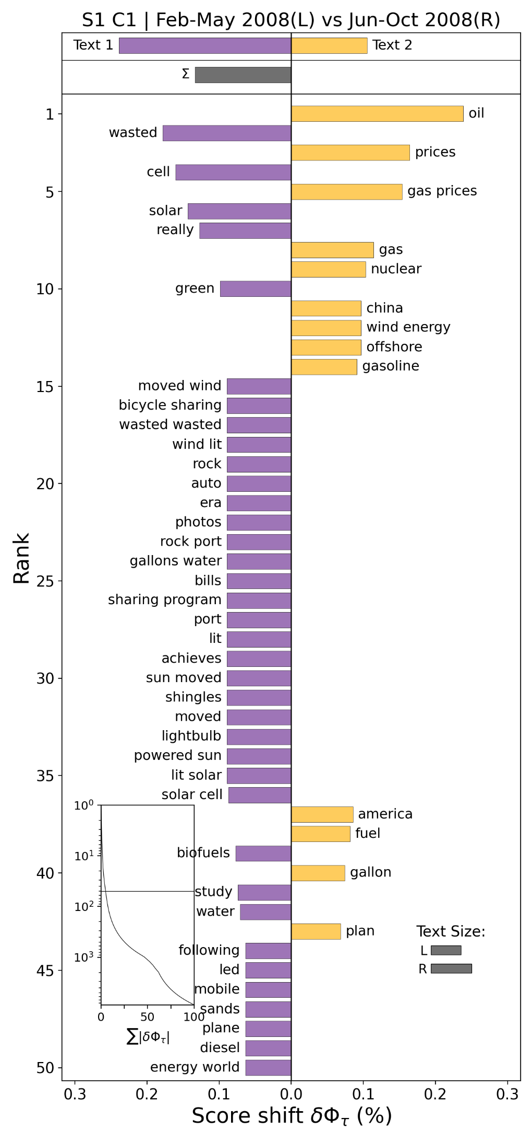
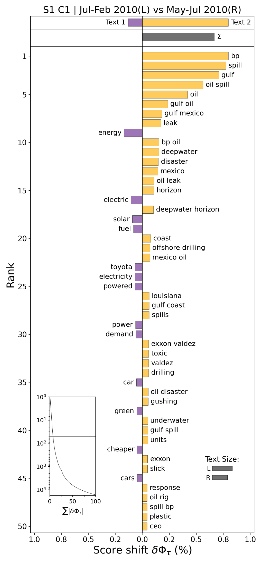
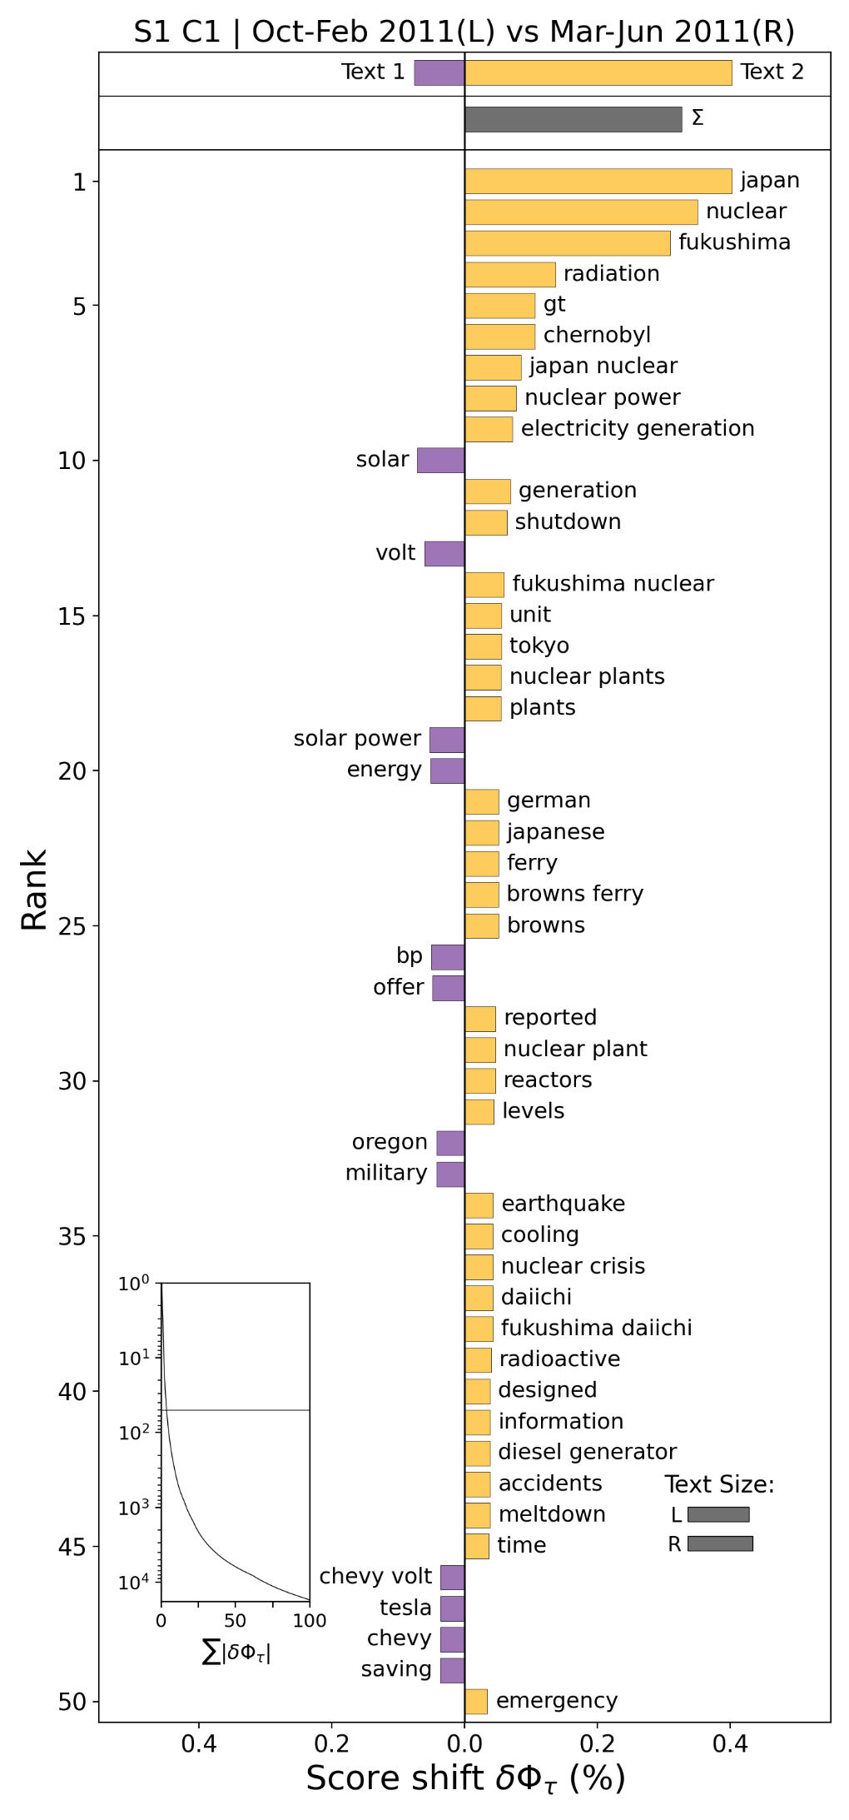
a
b
c

Slide 10
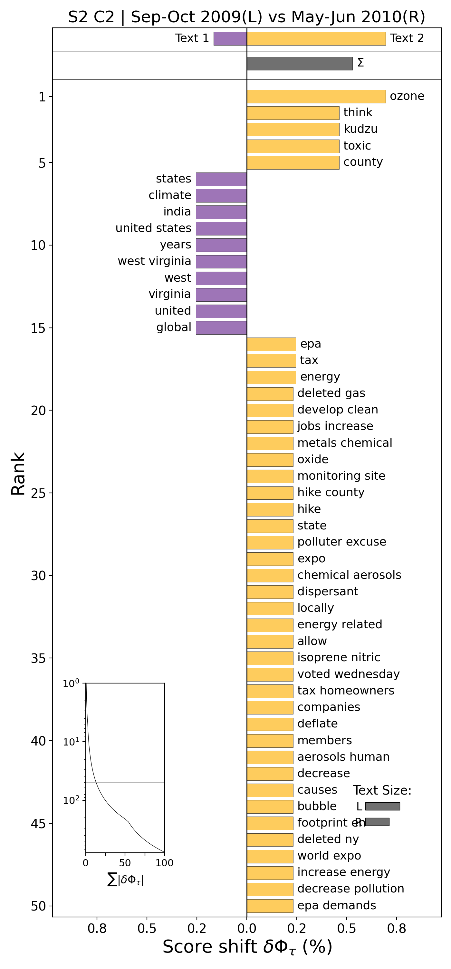
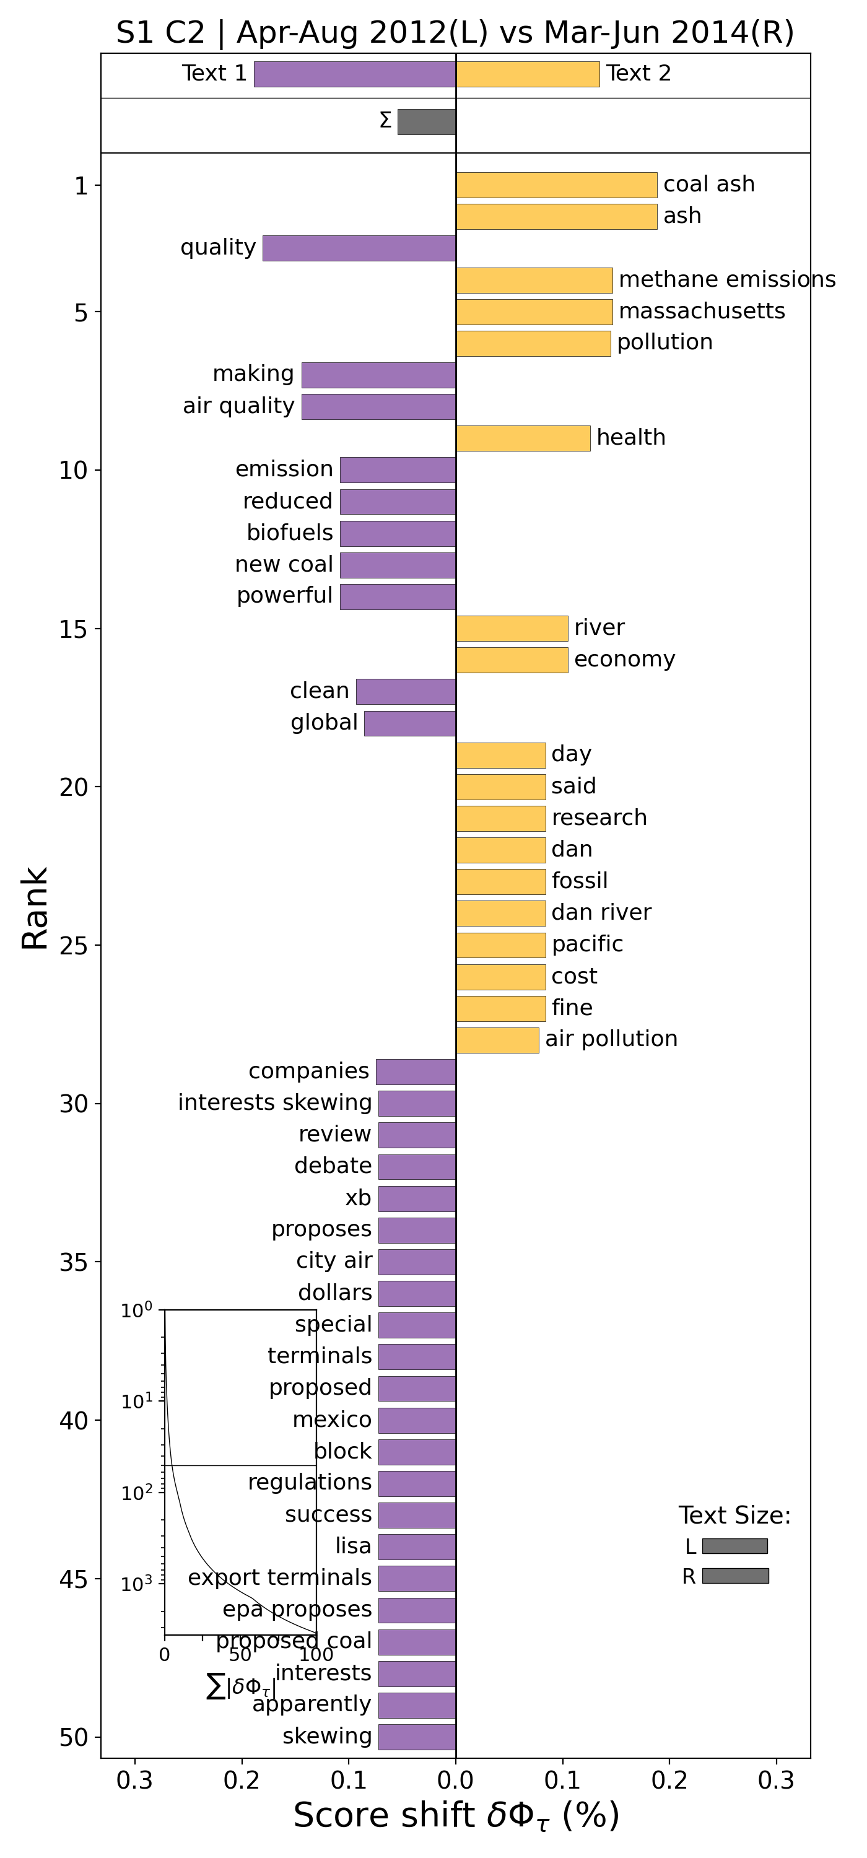
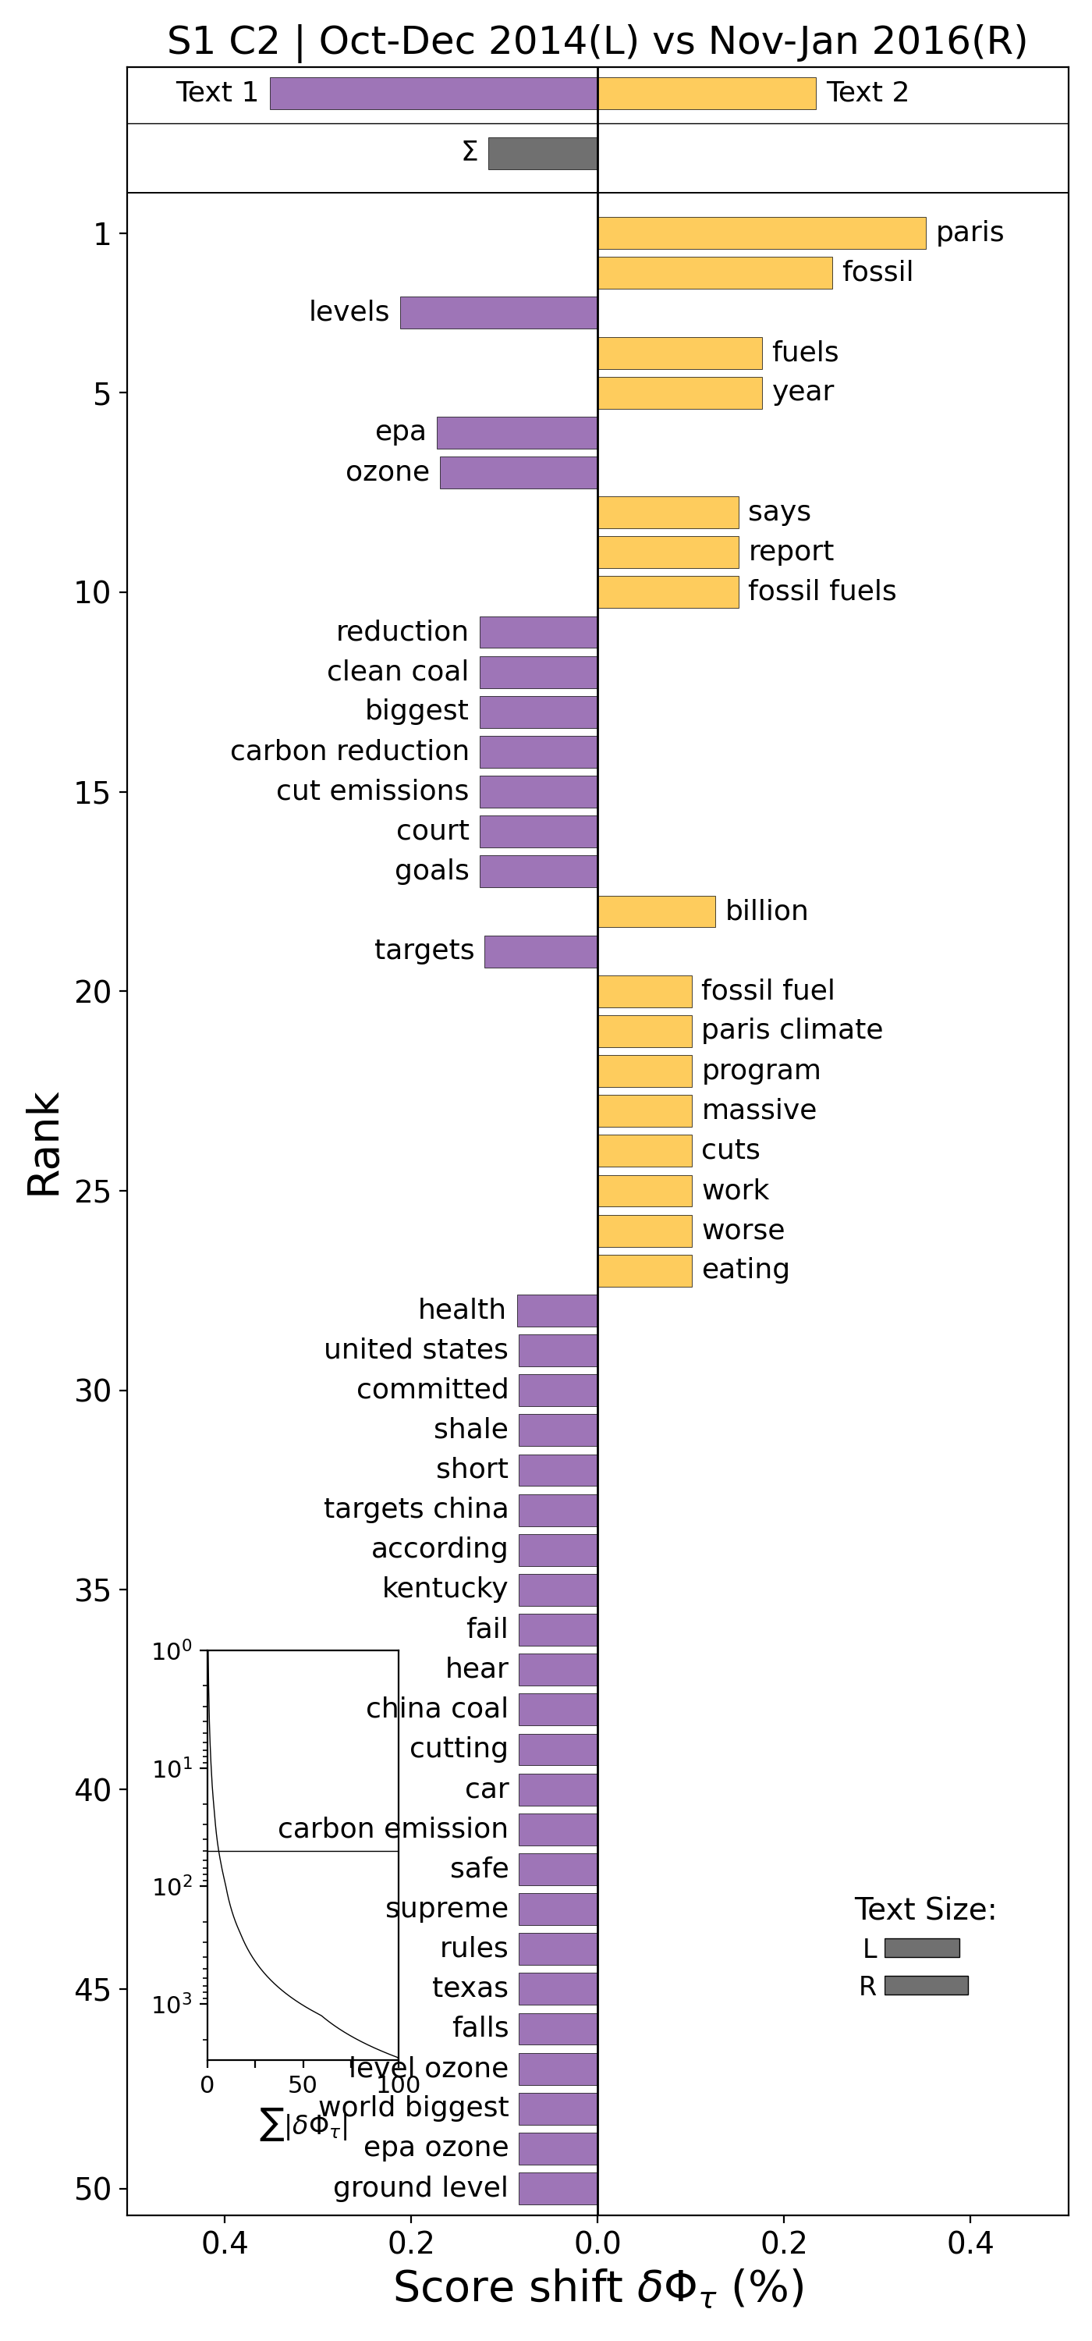
a
b
c

Slide 11
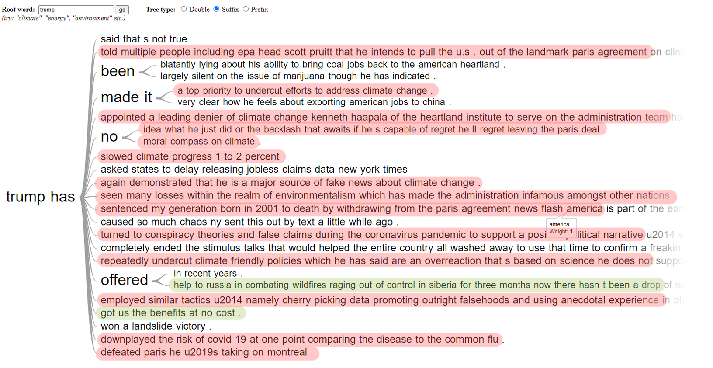
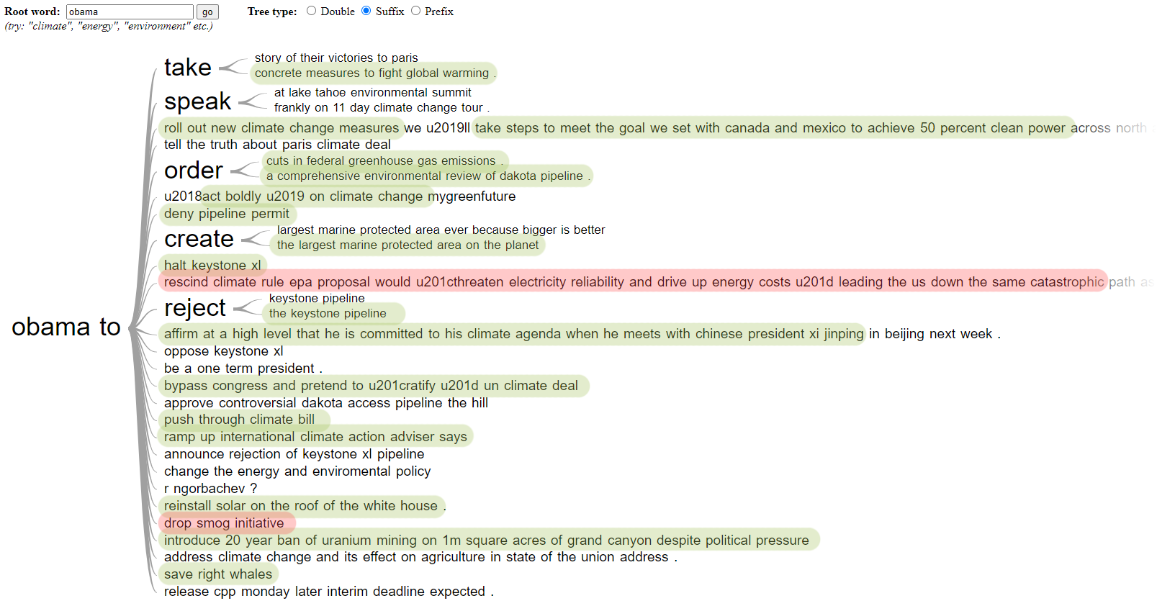
Negative phrases
Positive phrases
a
b

Slide 12
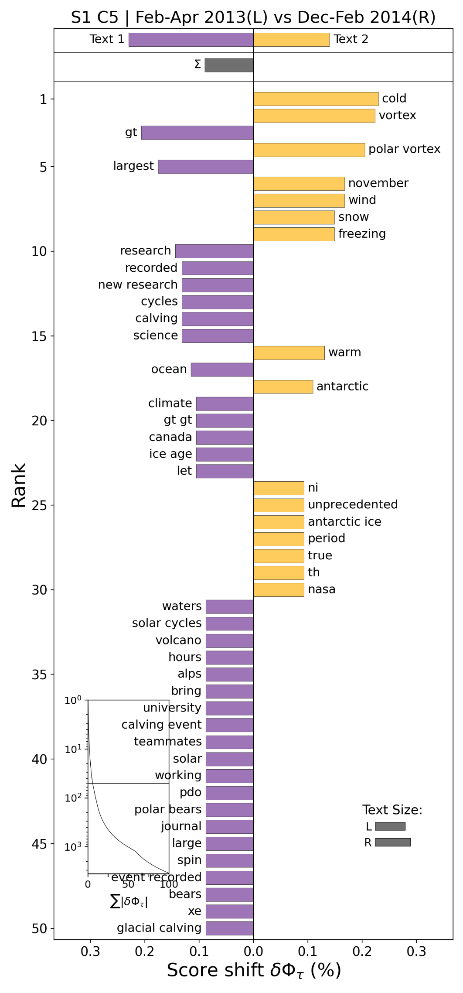
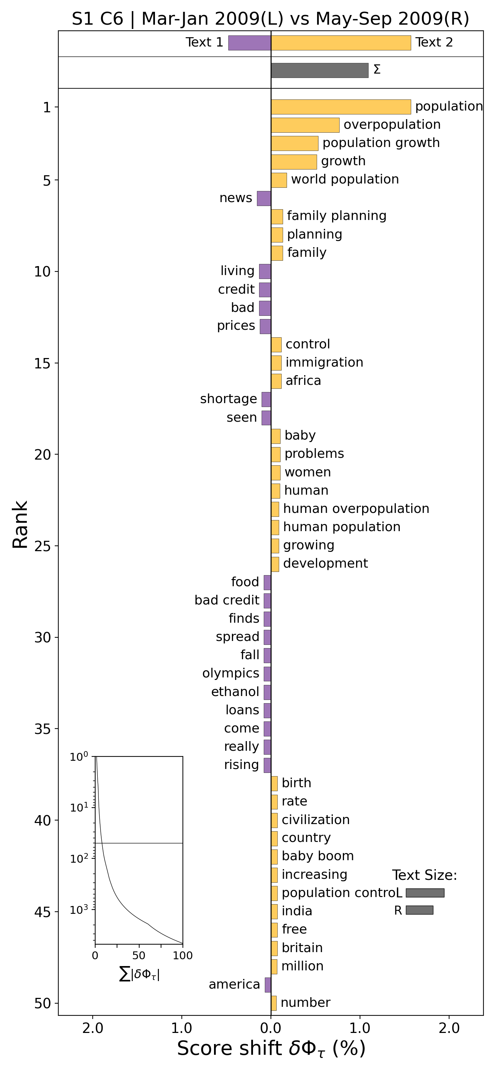
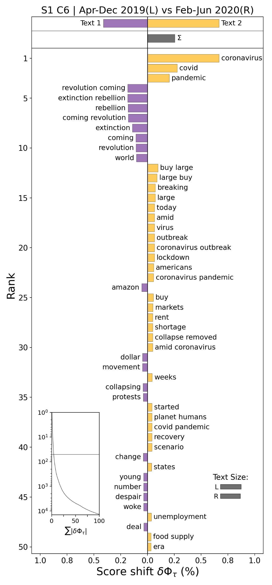
a
b
c

Slide 13
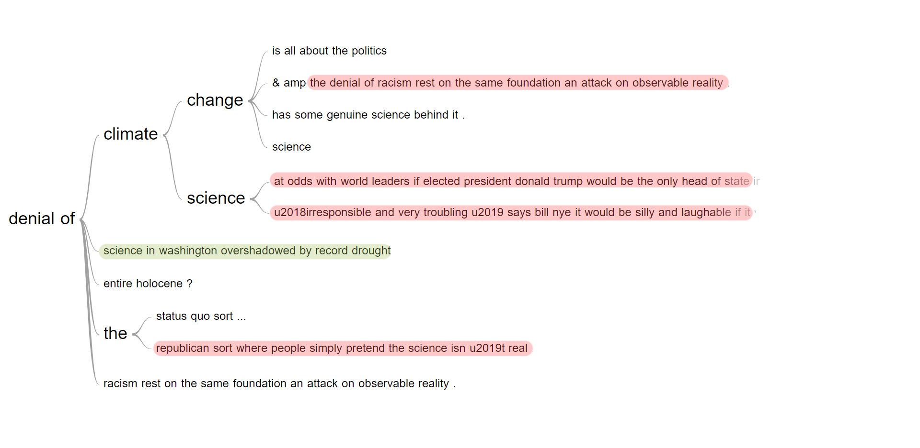
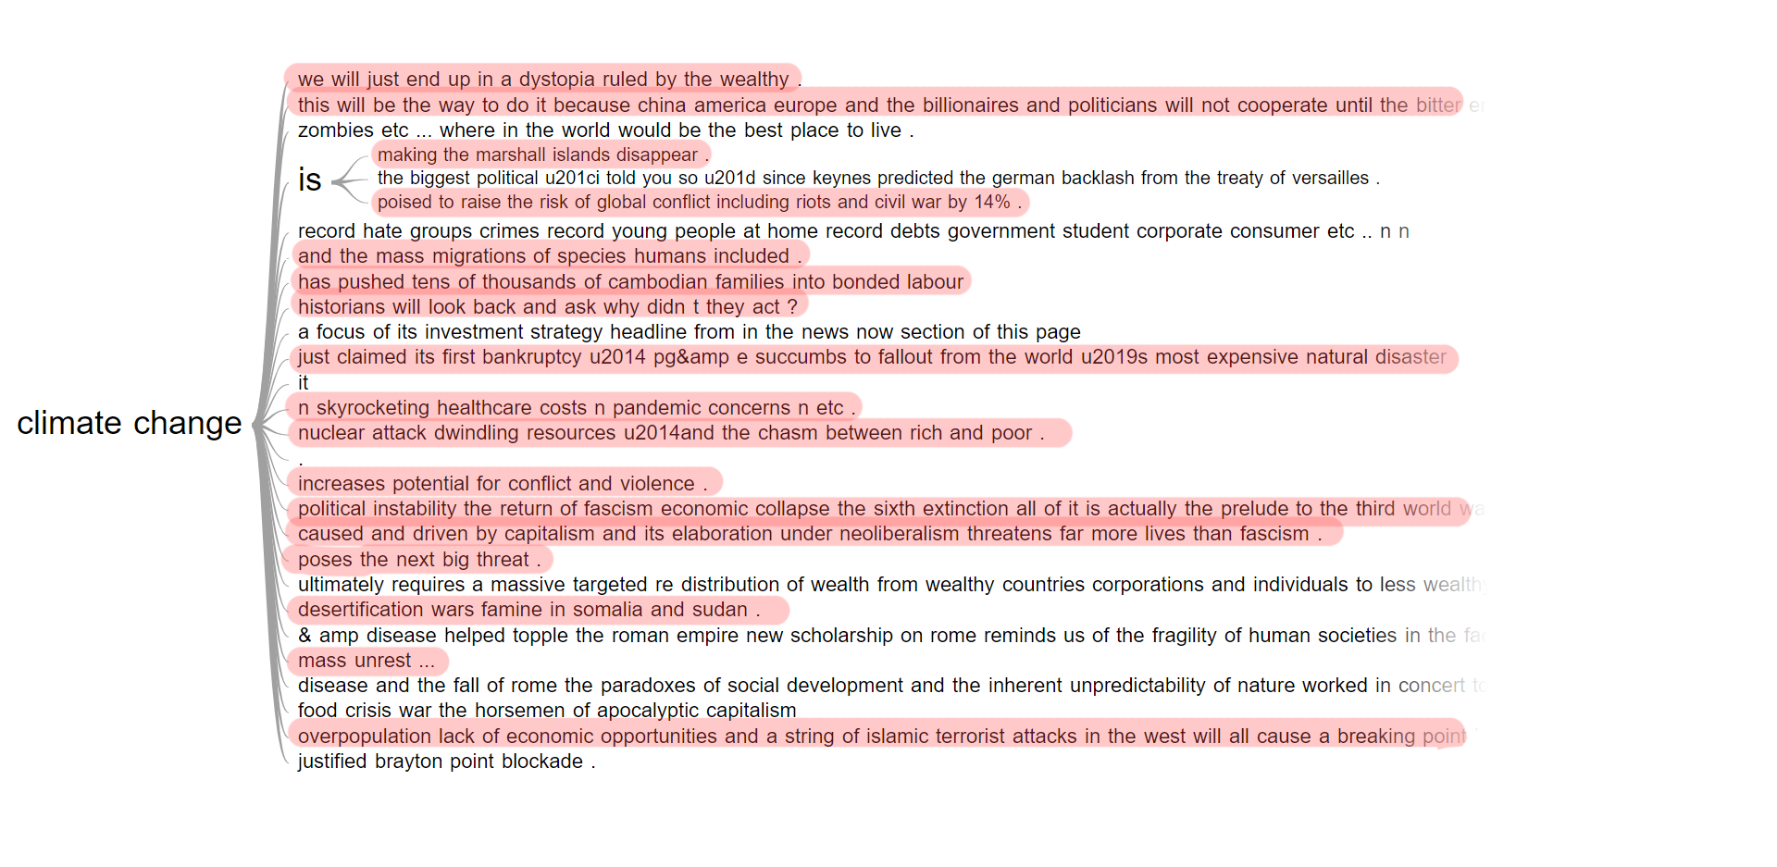
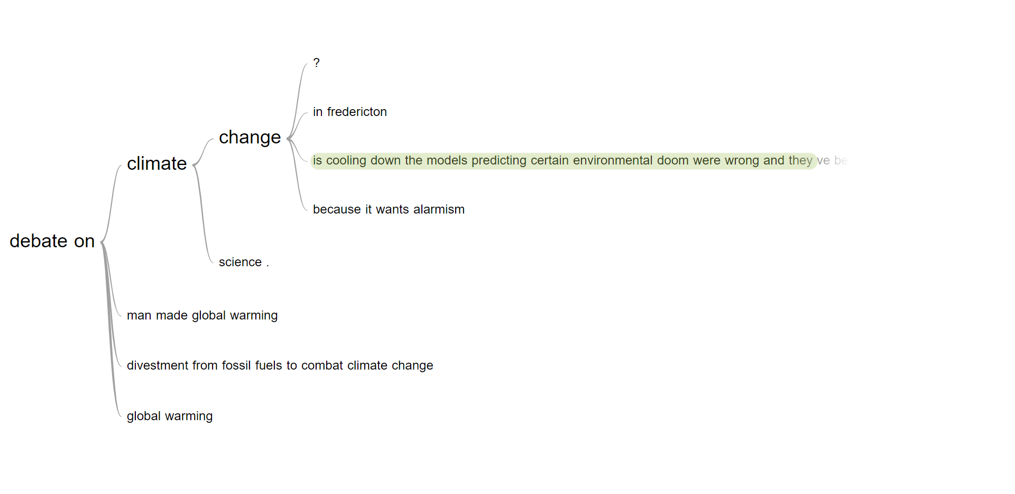
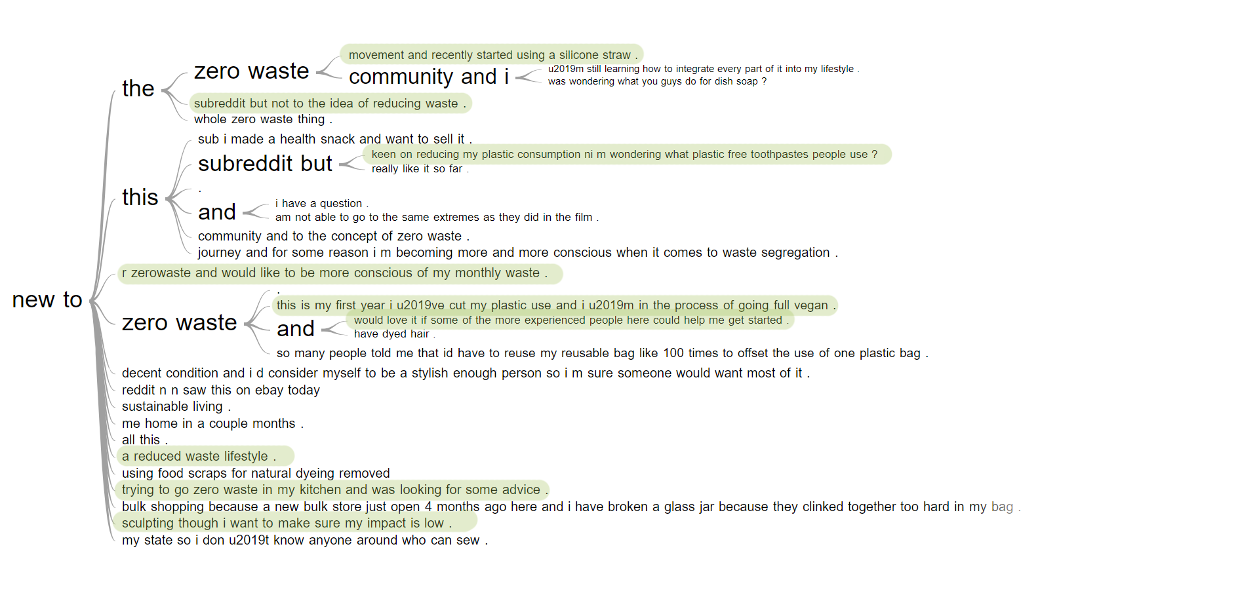
Negative phrases
Positive phrases
a
b
c
d

Slide 14
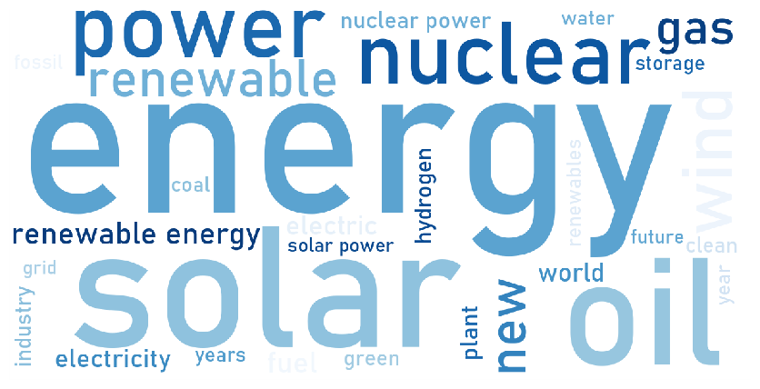
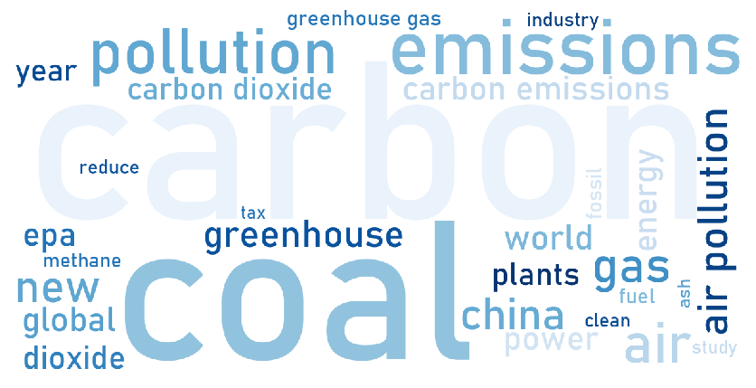
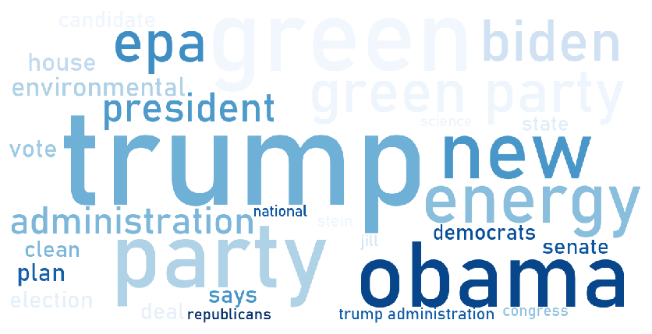
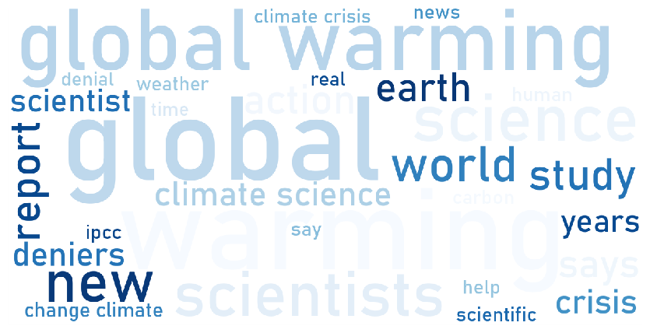
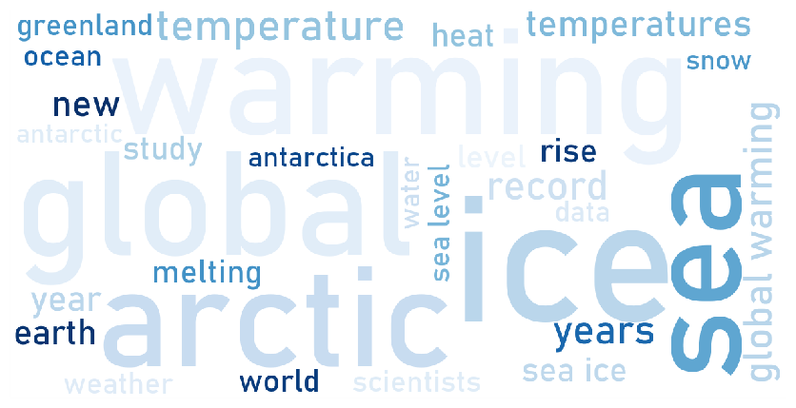
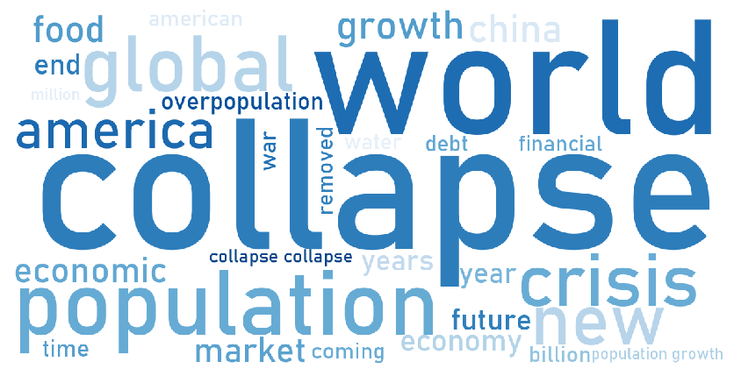






a
Cluster 1 - Energy
b
Cluster 2 - Carbon [emissions]
c
Cluster 3 - Administration
d
Cluster 4 - Climate science
e
Cluster 5 - Global warming
f
Cluster 6 - Population & economy
g
Cluster 7 - Plastic & waste
h
Cluster 8 – Agriculture and administration
i
Cluster 9 - Wildlife
j
Cluster 10 - Natural catastrophe
k
Cluster 11 - General posts
l
Cluster 12 - Unidentifiable

Slide 15












a
Cluster 1 - Energy
b
Cluster 2 - Carbon [emissions]
c
Cluster 3 - Administration
d
Cluster 4 - Climate science
e
Cluster 5 - Global warming
f
Cluster 6 - Population & economy
g
Cluster 7 - Plastic & waste
h
Cluster 8 – Agriculture
i
Cluster 9 - Wildlife
j
Cluster 10 - Natural catastrophe
k
Cluster 11 - General posts
l
Cluster 12 - Unidentifiable

Slide 16
Sample 1
Sample 2
Mean
+1 Std. Dev.
-1 Std. Dev.
a
b
c
1
2
3
4
6
7
8
5
d
e
f
3
2
9
3
10
1
1
Oil price shock (2008)
5
Focus of discussions shifted from “internal combustion engines vs. electric vehicles” to “fuel cell vehicles and building infrastructure for batteries”
8
IEA reports that Australian rooftop solar is among cheapest in the world (2015)
2
Deepwater Horizon oil spill (2010)
3
Fukushima nuclear disaster (2011)
9
France’s climate plan, and the public water supplies (Scotland) amendment regulations (2017)
4
World's first flight powered by biofuel takes off (2008)
6
EU renewable energy directive 2009/28/EC
7
US approves world's largest solar energy project (2010)
10
Fukushima’s radioactive water leak revealed (2013)

Slide 17



a
b
c

Slide 18



a
b
c

Slide 19



a
b
c

Slide 20



a
b
c

Slide 21



a
b
c

Slide 22



a
b
c

Slide 23



a
b
c

Slide 24



a
b
c

Slide 25


a
b

Slide 26



Negative phrases
Positive phrases
a
b
c

Slide 27



Negative phrases
Positive phrases
a
b
c

Slide 28



Negative phrases
Positive phrases
a
b
c

Slide 29



Negative phrases
Positive phrases
a
b
c

Slide 30
a
b
c
d
e
f
g
h
i
j
k
l

Slide 31
a
b
c
d
e
f
g
h
i
j
k
l

